Slide 1
Impact of Lightning on Buildings and Remedial Measures

Slide 2
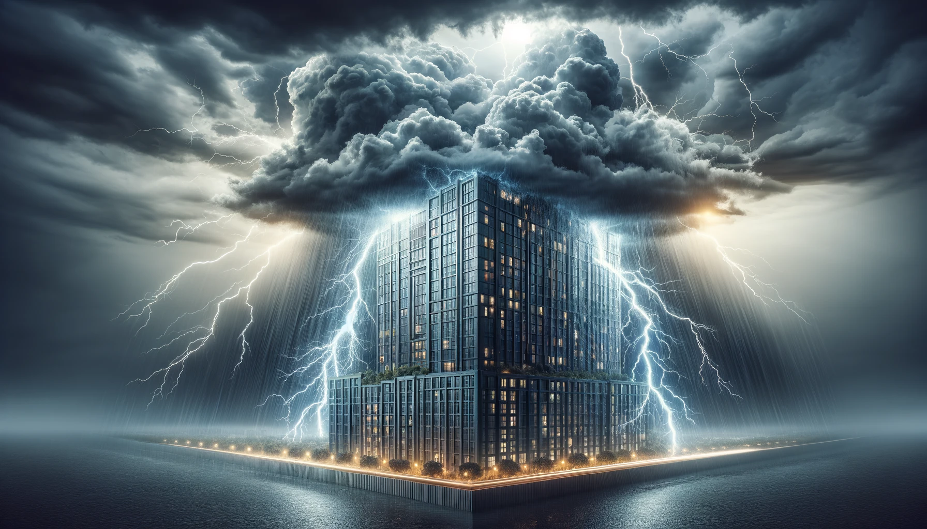

Slide 3
Introduction to Lightning
Lightning is a natural phenomenon characterized by a sudden electrostatic discharge during a thunderstorm.
Annually, there are approximately 1.4 billion lightning flashes worldwide, posing a significant risk to buildings and infrastructure.
Understanding lightning's impact is crucial for developing effective protection strategies and ensuring the safety and integrity of structures.

Slide 4
How Lightning Affects Buildings
Lightning can cause structural damage, fire, and failure of electrical systems within buildings.
Direct strikes can severely damage the structure, while indirect effects include surges that can destroy electronic equipment.
For instance, the Empire State Building is struck by lightning around 23 times a year but remains protected due to advanced lightning protection systems.

Slide 5
Vulnerable Points in Buildings
The most vulnerable parts include roofs, electrical lines, and any conductive paths that can transmit lightning's electrical energy into the building.
Lightning can cause punctures in roofing materials, ignite fires, and induce surges in power lines, leading to equipment damage.

Slide 6
Lightning Protection Systems (LPS)
An LPS is designed to protect structures from lightning damage by providing a direct path for the lightning charge to reach earth, dissipating the energy safely.
Key components include air terminals (lightning rods), down conductors, and a grounding system that together prevent damage by intercepting and safely directing the lightning strike to the ground.

Slide 7
Modern Remedial Measures
Technological advancements have led to the development of more efficient materials and systems, such as Early Streamer Emission (ESE) terminals and surge protection devices.
These modern solutions offer improved protection against lightning by rapidly equalizing potential differences and minimizing the risk of a direct strike or surge damage.

Slide 8
Case Study: Successful Implementation of Remedial Measures
The Petronas Towers in Kuala Lumpur, equipped with a comprehensive LPS, have successfully mitigated lightning risk, showcasing the effectiveness of modern protection measures.
Despite being among the tallest buildings in the world and located in a high-lightning activity area, there have been no significant incidents due to lightning since their construction.

Slide 9
Designing Buildings with Lightning in Mind
Integrating lightning protection in the architectural design phase is crucial for new buildings, especially in lightning-prone areas.
Architects and engineers should adhere to international standards and best practices, incorporating LPS elements seamlessly into the building's design to ensure both aesthetics and functionality.

Slide 10
Maintenance and Testing of Lightning Protection Systems
Regular maintenance and testing are vital to ensure the LPS's effectiveness over time.
It is recommended to conduct inspections at least annually or following significant storms to identify and rectify any damages or deterioration in the system components.

Slide 11
Global Standards and Regulations
International standards, such as IEC 62305 and NFPA 780, provide guidelines for the design, installation, and maintenance of LPS.
Adhering to these standards helps ensure a high level of protection and compliance with local building codes and regulations.

Slide 12
Conclusion
Lightning poses a significant risk to buildings, but understanding its impact and implementing effective remedial measures can greatly reduce this risk.
By adopting advanced protection systems and adhering to global standards, we can safeguard structures against lightning damage, ensuring their longevity and safety.

